Slide 1
Multiple Regression
Vishnuprasad Nagadevara
Indian Institute of Management Bangalore

Slide 2
Multiple Regression
Several independent variables may influence the response variable we are trying to study.
When several independent variables are included in the equation, the regression is called multiple regression.
Relationship between 1 dependent & 2 or more independent variables is a linear function

Slide 3
The Model
Explanatory Variables
Slopes - Population
Intercept-Population
Random Term
Dependent Variable

Slide 4
Estimated Equation
The equation estimated from the sample data
$$Y_{i}=\hat{a}+\hat{b_{1}}X_{1}+\hat{b_{2}}X_{2}+…+\hat{b_{k}}X_{k}+\hat{e_{i}}$$

Slide 5
Assumptions about Random Error e
  Same as in the case of Simple Linear Regression
    For any given set of values of x₁, x₂,…..x_{k}, the random error has a normal probability distribution with mean 0 and variance σ²
    The random errors are independent
  e_{i} ~ NID (0, σ²)
Launch Poll 1
Notes:
Poll 1: I had revised/reviewed Matrix algebra Yes/No

Slide 6
Matrix Notation
1 | X₁₁ | X₂₁ | . | X_{k1}
1 | X₁₂ | X₂₂ | . | X_{k2}
1 | X₁₃ | X₂₃ | . | X_{k3}
. | . | . | . | .
1 | X_{1n} | X_{2n} | . | X_{kn}
Y₁
Y₂
Y₃
.
Y_{n}
b₀
b₁
b₂
.
b_{k}
e₁
e₂
e₃
.
e_{n}
X =
Y =
B =
E =
The Model ➔
Y = XB + E
or E = [Y – XB]
(Y – XB)´
(Y – XB)
Error Sum of Squares = E´E =
(X´XB) = X´Y
Thus, the Normal Equations are
Multiplying both sides by (X´X)⁻¹
B = (X´X)⁻¹ X´Y

Slide 7
Example
Example – The Bendrix Company
  File – Bendrix.xls

Slide 8
OH Vs. Mach Hours

Slide 9
Scatter Plot OH Vs. Prod. Runs

Slide 10
Correlations
 | MachHrs | ProdRuns | Overhead
MachHrs | 1
ProdRuns | -0.2291 | 1
Overhead | 0.6319 | 0.5205 | 1

Slide 11
Regression
Interpretation of the coefficients
intercept
slopes

Slide 12
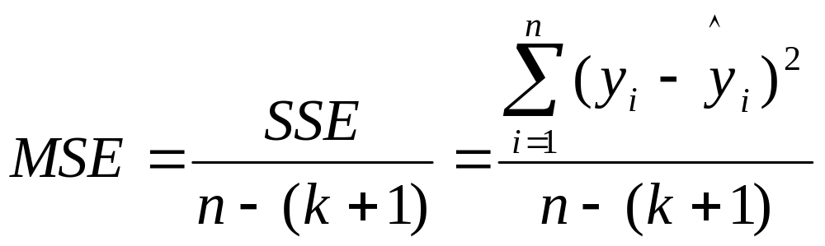
Validation of the model
1. Check the error mean square

Slide 13
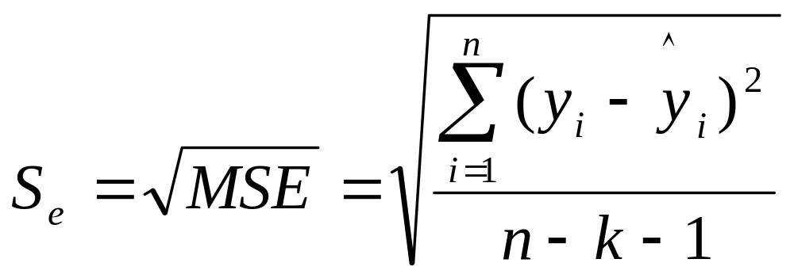
Standard Error of the Estimate

Slide 14
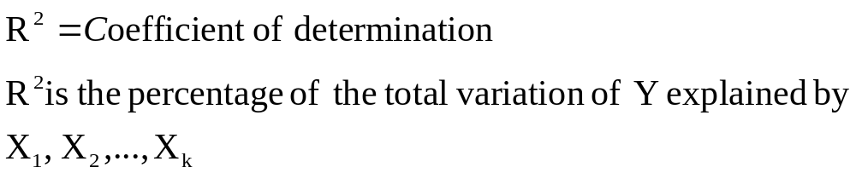
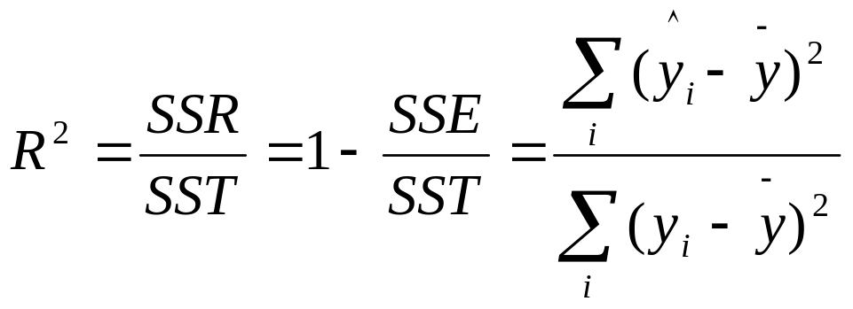
Coefficient of Determination
As the number of explanatory variables increase, R² will increase!
This can be misleading

Slide 15
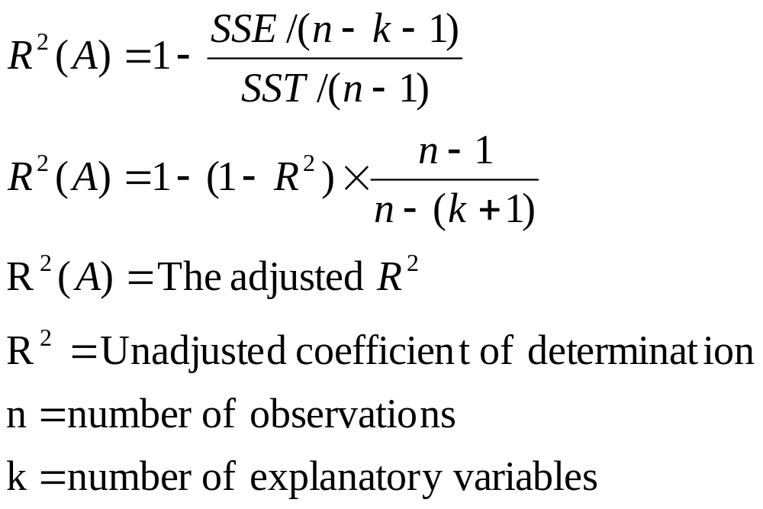
Adjusted R²
To correct this defect, we adjust the R² by taking into account the degrees of freedom.
Adjusted R² is a function of MSE and R²

Slide 16
Bendrix – Excel Output
Regression Statistics
Multiple R | 0.9308
R Square | 0.8664
Adjusted R Square | 0.8583
Standard Error | 4109
Observations | 36

Slide 17
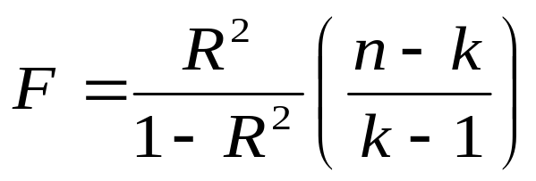
Hypothesis test of Overall Significance
  H₀: β₁ = β₂ = … = β_{j} = 0
  H_{A}: At least on β is different from Zero
Use ANOVA
 | df | SS | MS | F | Significance F
Regression | 2 (k-1) | 3.61E+09 (SSR) | 1.81E+09 (SSR/(k-1)) | 107.026 (MSR/MSE) | 3.75E-15
Residual | 33 (n-k) | 5.57E+08 (SSE) | 16883824 (SSE/(n-k))
Total | 35 (n-1) | 4.17E+09 (SST)
Where k = no. of coefficients estimated

Slide 18
Confidence Intervals
The Variance-Covariance Matrix is given by:
Cov (B) = S²e [X´X]⁻¹
The Diagonal Elements give the Variances
The Confidence Interval for is β_{i} given by
b_{i} ± (t_{α/2,df}){Se(b_{i})}
Confidence Level is (1 – α)

Slide 19
Hypothesis Test for Individual Parameters
  H₀: b₁ = 0
  H_{A}: b₁ ≠ 0
  H₀: b₂ = 0
  H_{A}: b₂ ≠ 0
t = (b₁ – 0)/Se(b₁)
=12.13
t = (b₂ – 0)/Se(b₂)
=10.74

Slide 20
Questions?

